Slide 1
Chapter 1:-
Conventional Encryption:
Classical Encryption
Techniques
Compiled By:- Akash Mehta
GIT.
Notes:
Akash Mehta

Slide 2
Outline
Conventional Encryption Model
Steganography
Classical Encryption Techniques
Akash Mehta
Notes:
Akash Mehta

Slide 3
Classical encryption techniques
As opposed to modern cryptography
Goals:
  to introduce basic concepts & terminology of encryption
  to prepare you for studying modern cryptography
Akash Mehta

Slide 4
Principles of Security
Security Goals:
Confidentiality
Integrity
Authentication
Non-repudiation
Access Control
Availability
Akash Mehta

Slide 5

Loss of Confidentiality
B
C
Attack:-Interception
Akash Mehta

Slide 6
Absence of Authentication
A
B
I am User A
C
Attack:-Fabrication
Akash Mehta

Slide 7

Loss of Integrity
B
C
Attack:-Modification
Akash Mehta
Notes:
Akash Mehta

Slide 8
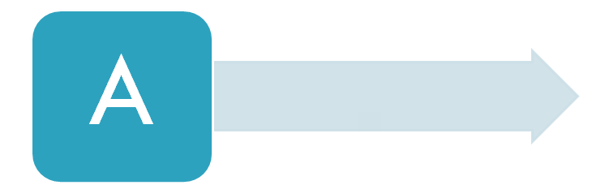
Non-repudiation
I never sent that message, which you claim to have received
B
Akash Mehta

Slide 9
Access Control
The principles of access control determines who should be able to access what.
Access control is broadly related to two areas: role management and rule management.
Akash Mehta

Slide 10
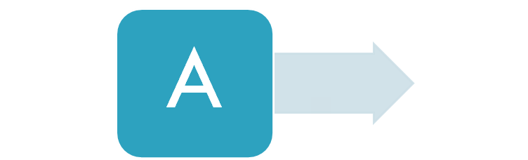
Loss of Availability
B
C
Attack:-Interruption
Akash Mehta

Slide 11
Basic terminology
Plaintext: original message to be encrypted
Ciphertext: the encrypted message
Enciphering or encryption: the process of converting plaintext into ciphertext
Encryption algorithm: performs encryption
  Two inputs: a plaintext and a secret key
Akash Mehta

Slide 12
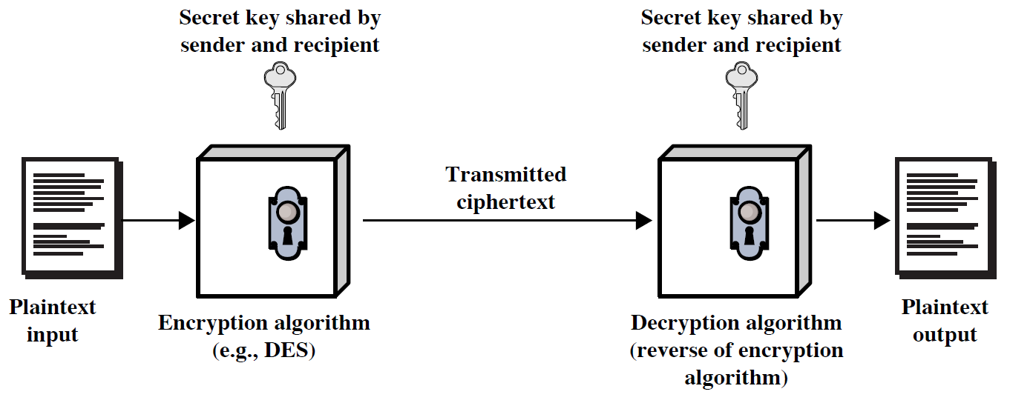
Symmetric Cipher Model
Akash Mehta
Notes:
Akash Mehta

Slide 13
Contd…
Deciphering or decryption: recovering plaintext from ciphertext
Decryption algorithm: performs decryption
  Two inputs: ciphertext and secret key
Secret key: same key used for encryption and decryption
  Also referred to as a symmetric key
Akash Mehta

Slide 14
Contd…
Cipher or cryptographic system : a scheme for encryption and decryption
Cryptography: science of studying ciphers
Cryptanalysis: science of studying attacks against cryptographic systems
Cryptology: cryptography + cryptanalysis
Akash Mehta

Slide 15
Ciphers
Symmetric cipher: same key used for encryption and decryption
  Block cipher: encrypts a block of plaintext at a time (typically 64 or 128 bits)
  Stream cipher: encrypts data one bit or one byte at a time
Asymmetric cipher: different keys used for encryption and decryption
Akash Mehta

Slide 16
Symmetric Encryption
or conventional / secret-key / single-key
sender and recipient share a common key
all classical encryption algorithms are symmetric
The only type of ciphers prior to the invention of asymmetric-key ciphers in 1970’s
by far most widely used
Akash Mehta
Notes:
Akash Mehta

Slide 17
Symmetric Encryption
Mathematically:
  Y = E_{K}(X) or Y = E(K, X)
  X = D_{K}(Y) or X = D(K, Y)
X = plaintext
Y = ciphertext
K = secret key
E = encryption algorithm
D = decryption algorithm
Both E and D are known to public
Akash Mehta
Notes:
Akash Mehta

Slide 18
Cryptanalysis
Objective: to recover the plaintext of a ciphertext or, more typically, to recover the secret key.
Kerkhoff’s principle: the adversary knows all details about a cryptosystem except the secret key.
Two general approaches:
  brute-force attack
  non-brute-force attack (cryptanalytic attack)
Akash Mehta
Notes:
Akash Mehta

Slide 19
Brute-Force Attack
Try every key to decipher the ciphertext.
On average, need to try half of all possible keys
Time needed proportional to size of key space
Key Size (bits) | Number of Alternative Keys | Time required at 1 decryption/µs | Time required at 10⁶ decryptions/µs
32 | 2³² = 4.3 × 10⁹ | 2³¹ µs = 35.8 minutes | 2.15 milliseconds
56 | 2⁵⁶ = 7.2 × 10¹⁶ | 2⁵⁵ µs = 1142 years | 10.01 hours
128 | 2¹²⁸ = 3.4 × 10³⁸ | 2¹²⁷ µs = 5.4 × 10²⁴ years | 5.4 × 10¹⁸ years
168 | 2¹⁶⁸ = 3.7 × 10⁵⁰ | 2¹⁶⁷ µs = 5.9 × 10³⁶ years | 5.9 × 10³⁰ years
26 characters (permutation) | 26! = 4 × 10²⁶ | 2 × 10²⁶ µs = 6.4 × 10¹² years | 6.4 × 10⁶ years
Akash Mehta
Notes:
Akash Mehta

Slide 20
Cryptanalytic Attacks
May be classified by how much information needed by the attacker:
  Ciphertext-only attack
  Known-plaintext attack
  Chosen-plaintext attack
  Chosen-ciphertext attack
Akash Mehta

Slide 21
Ciphertext-only attack
Given: a ciphertext c
Q: what is the plaintext m?
An encryption scheme is completely insecure if it cannot resist ciphertext-only attacks.
Akash Mehta

Slide 22
Known-plaintext attack
Given: (m₁,c₁), (m₂,c₂), …, (m_{k},c_{k}) and a new ciphertext c.
Q: what is the plaintext of c?
Q: what is the secret key in use?
Akash Mehta

Slide 23
Chosen-plaintext attack
Given: (m₁,c₁), (m₂,c₂), …, (m_{k},c_{k}), where m₁, m₂, …, m_{k} are chosen by the adversary; and a new ciphertext c.
Q: what is the plaintext of c, or what is the secret key?
Akash Mehta

Slide 24
Example: chosen-plaintext attack
In 1942, US Navy cryptanalysts discovered that Japan was planning an attack on “AF”.
They believed that “AF” means Midway island.
Pentagon didn’t think so.
US forces in Midway sent a plain message that their freshwater supplies were low.
Shortly, US intercepted a Japanese ciphertext saying that “AF” was low on water.
This proved that “AF” is Midway.
Akash Mehta

Slide 25
Chosen-ciphertext attack
Given: (m₁,c₁), (m₂,c₂), …, (m_{k},c_{k}), where c₁, c₂, …, c_{k} are chosen by the adversary; and a new ciphertext c.
Q: what is the plaintext of c, or what is the secret key?
Akash Mehta

Slide 26
Classical Ciphers
Plaintext is viewed as a sequence of elements (e.g., bits or characters)
Substitution cipher: replacing each element of the plaintext with another element.
Transposition (or permutation) cipher: rearranging the order of the elements of the plaintext.
Product cipher: using multiple stages of substitutions and transpositions
Akash Mehta
Notes:
Akash Mehta

Slide 27
Caesar Cipher
Earliest known substitution cipher
Invented by Julius Caesar
Each letter is replaced by the letter three positions further down the alphabet.
  Plain: a b c d e f g h i j k l m n o p q r s t u v w x y z
  Cipher: D E F G H I J K L M N O P Q R S T U V W X Y Z A B C
Example: ohio state → RKLR VWDWH
Akash Mehta
Notes:
Akash Mehta

Slide 28
Caesar Cipher
Mathematically, map letters to numbers:
  a, b, c, ..., x, y, z
  0, 1, 2, ..., 23, 24, 25
Then the general Caesar cipher is:
  c = E_{K}(p) = (p + k) mod 26
  p = D_{K}(c) = (c – k) mod 26
Can be generalized with any alphabet.
Akash Mehta
Notes:
Akash Mehta

Slide 29
Cryptanalysis of Caesar Cipher
Key space: {0, 1, ..., 25}
Vulnerable to brute-force attacks.
E.g., break ciphertext “KHOOR“
Answer is: “HELLO”
Akash Mehta
Notes:
Akash Mehta

Slide 30
Monoalphabetic Substitution Cipher
Shuffle the letters and map each plaintext letter to a different random ciphertext letter:
  Plain letters: abcdefghijklmnopqrstuvwxyz
  Cipher letters: DKVQFIBJWPESCXHTMYAUOLRGZN
  Plaintext: ifwewishtoreplaceletters
  Ciphertext: WIRFRWAJUHYFTSDVFSFUUFYA
What does a key look like?
Akash Mehta
Notes:
Akash Mehta

Slide 31
Monoalphabetic Cipher Security
Now we have a total of 26! = 4 x 10²⁶ keys.
With so many keys, it is secure against brute-force attacks.
But not secure against some cryptanalytic attacks.
Problem is language characteristics.
Akash Mehta
Notes:
Akash Mehta

Slide 32
Language Statistics and Cryptanalysis
Human languages are not random.
Letters are not equally frequently used.
In English, E is by far the most common letter, followed by T, A, R, N, I, O, S.
Other letters like Z, J, K, Q, X are fairly rare.
There are tables of single, double & triple letter frequencies for various languages
Akash Mehta
Notes:
Akash Mehta

Slide 33
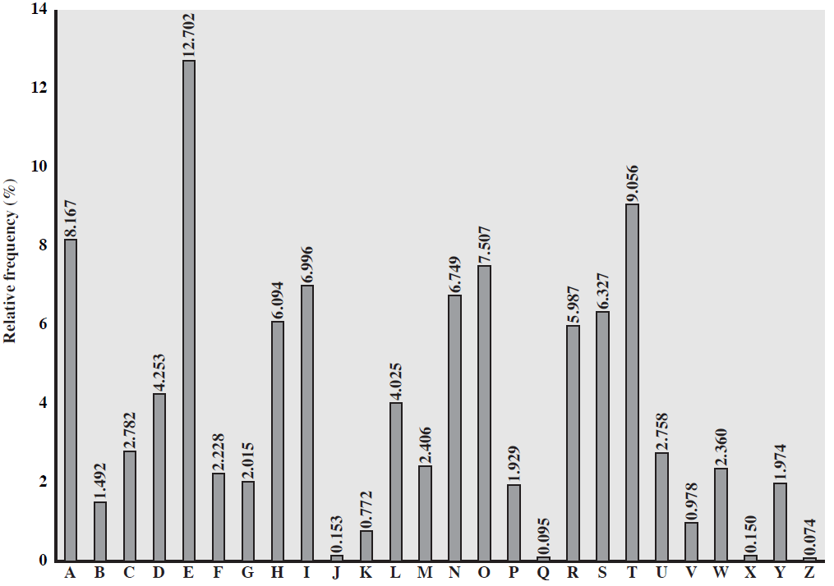
English Letter Frequencies
Akash Mehta
Notes:
Akash Mehta

Slide 34
Statistics for double & triple letters
In decreasing order of frequency
Double letters:
to he an in re on, …
Triple letters:
the and for nab, …
Akash Mehta

Slide 35
Use in Cryptanalysis
Key concept: monoalphabetic substitution does not change relative letter frequencies
To attack, we
  calculate letter frequencies for ciphertext
  compare this distribution against the known one
Akash Mehta
Notes:
Akash Mehta

Slide 36
Example Cryptanalysis
Given ciphertext:
  UZQSOVUOHXMOPVGPOZPEVSGZWSZOPFPESXUDBMETSXAIZ
  VUEPHZHMDZSHZOWSFPAPPDTSVPQUZWYMXUZUHSX
  EPYEPOPDZSZUFPOMBZWPFUPZHMDJUDTMOHMQ
Count relative letter frequencies (see next page)
Guess {P, Z} = {e, t}
Of double letters, ZW has highest frequency, so guess ZW = th and hence ZWP = the
Proceeding with trial and error finally get:
  it was disclosed yesterday that several informal but
  direct contacts have been made with political
  representatives of the viet cong in moscow
Akash Mehta
Notes:
Akash Mehta

Slide 37
Letter frequencies in ciphertext
P 13.33 | H 5.83 | F 3.33 | B 1.67 | C 0.00
Z 11.67 | D 5.00 | W 3.33 | G 1.67 | K 0.00
S 8.33 | E 5.00 | Q 2.50 | Y 1.67 | L 0.00
U 8.33 | V 4.17 | T 2.50 | I 0.83 | N 0.00
O 7.50 | X 4.17 | A 1.67 | J 0.83 | R 0.00
M 6.67
Akash Mehta

Slide 38
Polyalphabetic Substitution Ciphers
A sequence of monoalphabetic ciphers (M₁, M₂, M₃, ..., M_{k}) is used in turn to encrypt letters.
A key determines which sequence of ciphers to use.
Each plaintext letter has multiple corresponding ciphertext letters.
This makes cryptanalysis harder since the letter frequency distribution will be flatter.
Akash Mehta
Notes:
Akash Mehta

Slide 39
Example(Poly): Vigenère Cipher
Simplest polyalphabetic substitution cipher
Consider the set of all Caesar ciphers:
{ C_{a}, C_{b}, C_{c}, ..., C_{z} }
Key: e.g. security
Encrypt each letter using C_{s}, C_{e}, C_{c}, C_{u}, C_{r}, C_{i}, C_{t}, C_{y} in turn.
Repeat from start after C_{y}.
Decryption simply works in reverse.
Akash Mehta
Notes:
Akash Mehta

Slide 40
Example of Vigenère Cipher
Keyword: deceptive
  key: deceptivedeceptivedeceptive
  plaintext: wearediscoveredsaveyourself
  ciphertext: ZICVTWQNGRZGVTWAVZHCQYGLMGJ
Akash Mehta
Notes:
Akash Mehta

Slide 41
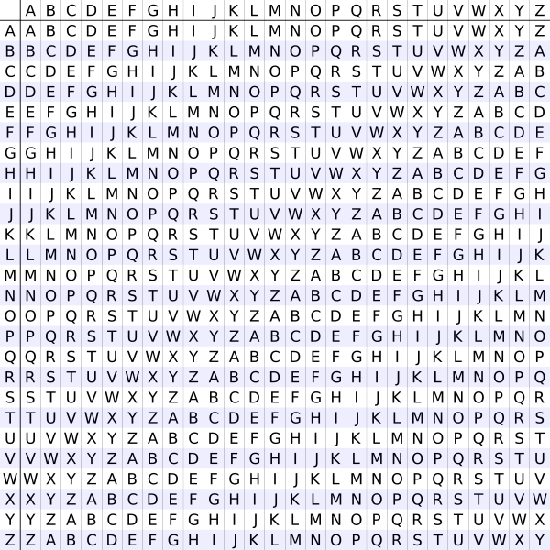
Plain Text
Key
Akash Mehta

Slide 42
Playfair Cipher
Not even the large number of keys in a monoalphabetic cipher provides security.
One approach to improving security is to encrypt multiple letters at a time.
The Playfair Cipher is the best known such cipher.
Invented by Charles Wheatstone in 1854, but named after his friend Baron Playfair.
Akash Mehta
Notes:
Akash Mehta

Slide 43
Playfair Key Matrix
Use a 5 x 5 matrix.
Fill in letters of the key (w/o duplicates).
Fill the rest of matrix with other letters.
E.g., key = MONARCHY.
M | O | N | A | R
C | H | Y | B | D
E | F | G | I/J | K
L | P | Q | S | T
U | V | W | X | Z
Akash Mehta
Notes:
Akash Mehta

Slide 44
Encrypting and Decrypting
Plaintext is encrypted two letters at a time.
  If a pair is a repeated letter, insert filler like 'X’.
  If both letters fall in the same row, replace each with the letter to its right (circularly).
  If both letters fall in the same column, replace each with the the letter below it (circularly).
  Otherwise, each letter is replaced by the letter in the same row but in the column of the other letter of the pair.
Akash Mehta
Notes:
Akash Mehta

Slide 45
Example of Playfair Cipher
Key: MONARCHY
Plaintext: BALLOON
        BA LX LO ON
Ciphertext: IB SU PM NA
M | O | N | A | R
C | H | Y | B | D
E | F | G | I/J | K
L | P | Q | S | T
U | V | W | X | Z
Akash Mehta

Slide 46
Security of Playfair Cipher
Security is much improved over the simple monoalphabetic cipher.
Was widely used for many decades
  eg. by US & British military in WW1 and early WW2
Once thought to be unbreakable.
Actually, it can be broken, because it still leaves some structure of plaintext intact.
Akash Mehta
Notes:
Akash Mehta

Slide 47
Rotor Cipher Machines
Before modern ciphers, rotor machines were most common complex ciphers in use.
Widely used in WW2.
Used a series of rotating cylinders.
Implemented a polyalphabetic substitution cipher of period K.
With 3 cylinders, K = 26³ =17,576.
With 5 cylinders, K = 26⁵ =12 x 10⁶.
What is a key?
  If the adversary has a machine
  If the adversary doesn’t have a machine
Akash Mehta
Notes:
Akash Mehta

Slide 48
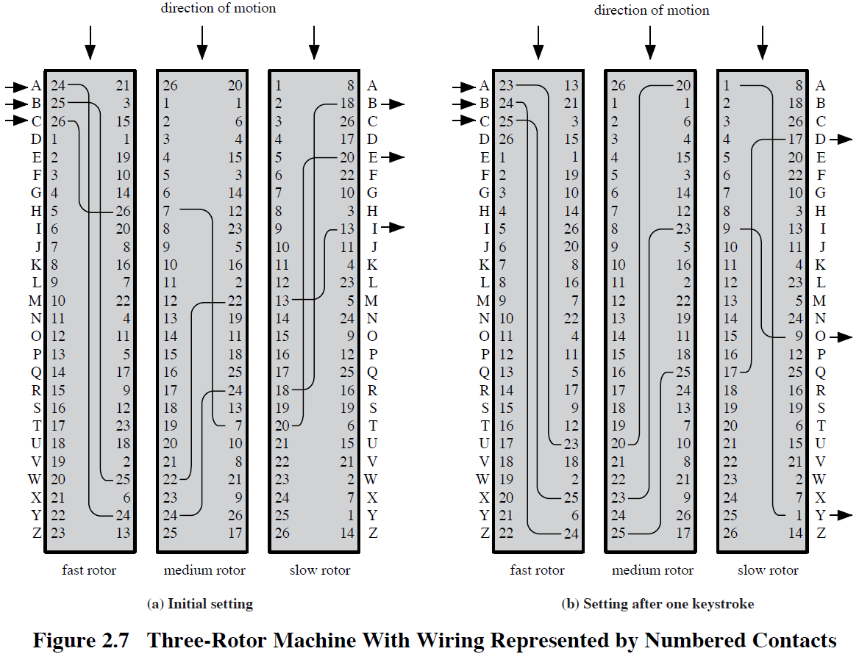
Akash Mehta

Slide 49
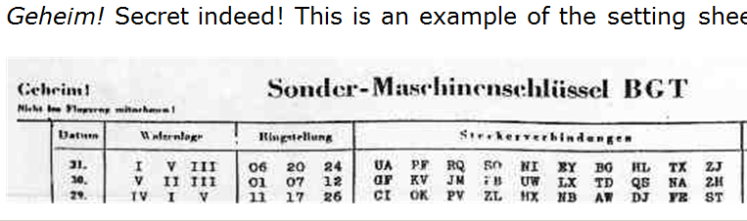
German secret setting sheets
Date
Which rotors to use (there were 10 rotors)
Ring setting
Plugboard setting
Akash Mehta

Slide 50
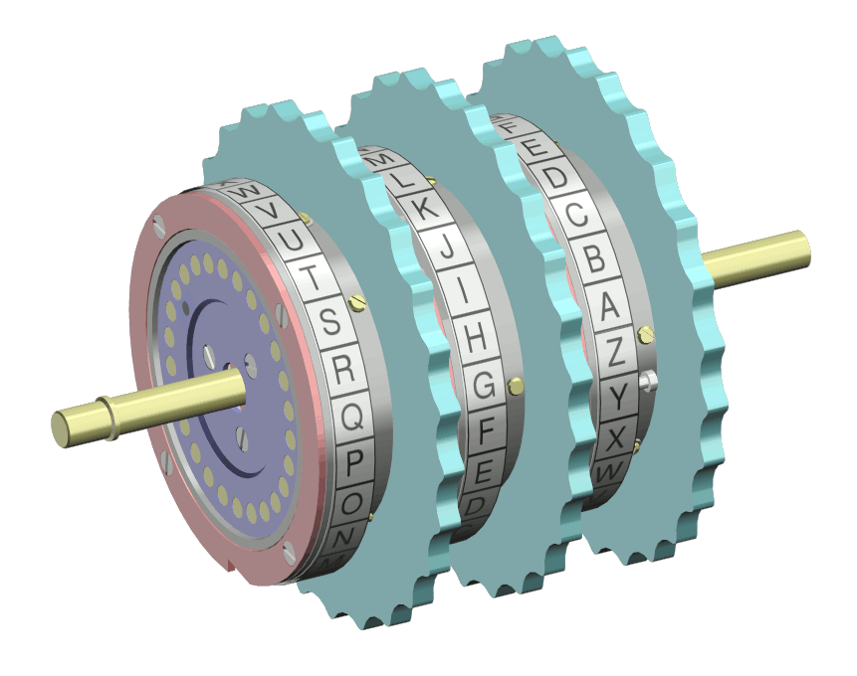
The Rotors
Akash Mehta
Notes:
Akash Mehta

Slide 51
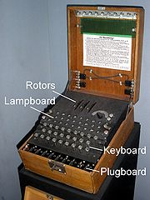
Enigma Rotor Machine
Akash Mehta
Notes:
Akash Mehta

Slide 52
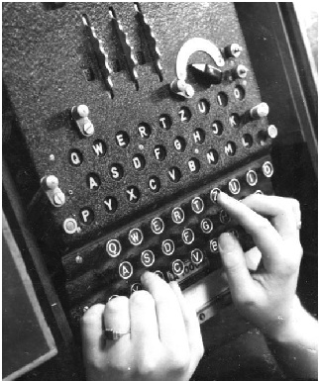
Enigma Rotor Machine
Akash Mehta
Notes:
Akash Mehta

Slide 53
Transposition Ciphers
Also called permutation ciphers.
Shuffle the plaintext, without altering the actual letters used.
Example: i) Columnar Transposition Ciphers
        ii) Rail Fence Technique
Akash Mehta
Notes:
Akash Mehta

Slide 54
Columnar Transposition Ciphers
Plaintext is written row by row in a rectangle.
Ciphertext: write out the columns in an order specified by a key.
  Key: 3 4 2 1 5 6
  Plaintext:
  Ciphertext: MTOR EOWN OERE CMRT HMAO OOFA
C | O | M | E | H | O
M | E | T | O | M | O
R | R | O | W | A | F
T | E | R | N | O | O
Akash Mehta
Notes:
Akash Mehta

Slide 55
Rail Fence Technique
Rail fence technique involves writing plain text as sequence of diagonals and then reading it row-by-row to produce cipher text.
Plain Text: COME HOME TOMORROW
C M H M T M R O
O E O E O O R W
Cipher Text: CMHMTMRO OEOEOORW
Akash Mehta

Slide 56
Product Ciphers
Uses a sequence of substitutions and transpositions
  Harder to break than just substitutions or transpositions
This is a bridge from classical to modern ciphers.
Akash Mehta
Notes:
Akash Mehta

Slide 57
Steganography
Hide a message in another message.
Invisible ink, Tiny pin punctures or minute variations between handwritten characters, pencil marks etc.
E.g., hide your plaintext in a graphic image
  Each pixel has 3 bytes specifying the RGB color
  The least significant bits of pixels can be changed w/o greatly affecting the image quality
  So can hide messages in these LSBs
Akash Mehta
Notes:
Akash Mehta

Slide 58
Summary
Have considered:
  classical cipher techniques and terminology
  monoalphabetic substitution ciphers
  cryptanalysis using letter frequencies
  Playfair cipher
  polyalphabetic ciphers
  transposition ciphers
  product ciphers and rotor machines
  Steganography
Akash Mehta
Notes:
Akash Mehta

Slide 59
Symmetric | Asymmetric
Symmetric cryptography uses the same secret (private) key to encrypt and decrypt its data | Asymmetric uses both a public and private key
Symmetric requires that the secret key be known by the party encrypting the data and the party decrypting the data | Asymmetric allows for distribution of your public key to anyone with which they can encrypt the data they want to send securely and then it can only be decoded by the person having the private key
Faster than Asymmetric | The issue with asymmetric is that it is about 1000 times slower than symmetric encryption which makes it impractical when trying to encrypt large amounts of data
Less Security compare to Asymmetric | Stronger Security compare to Symmetric
Akash Mehta

